Slide 1
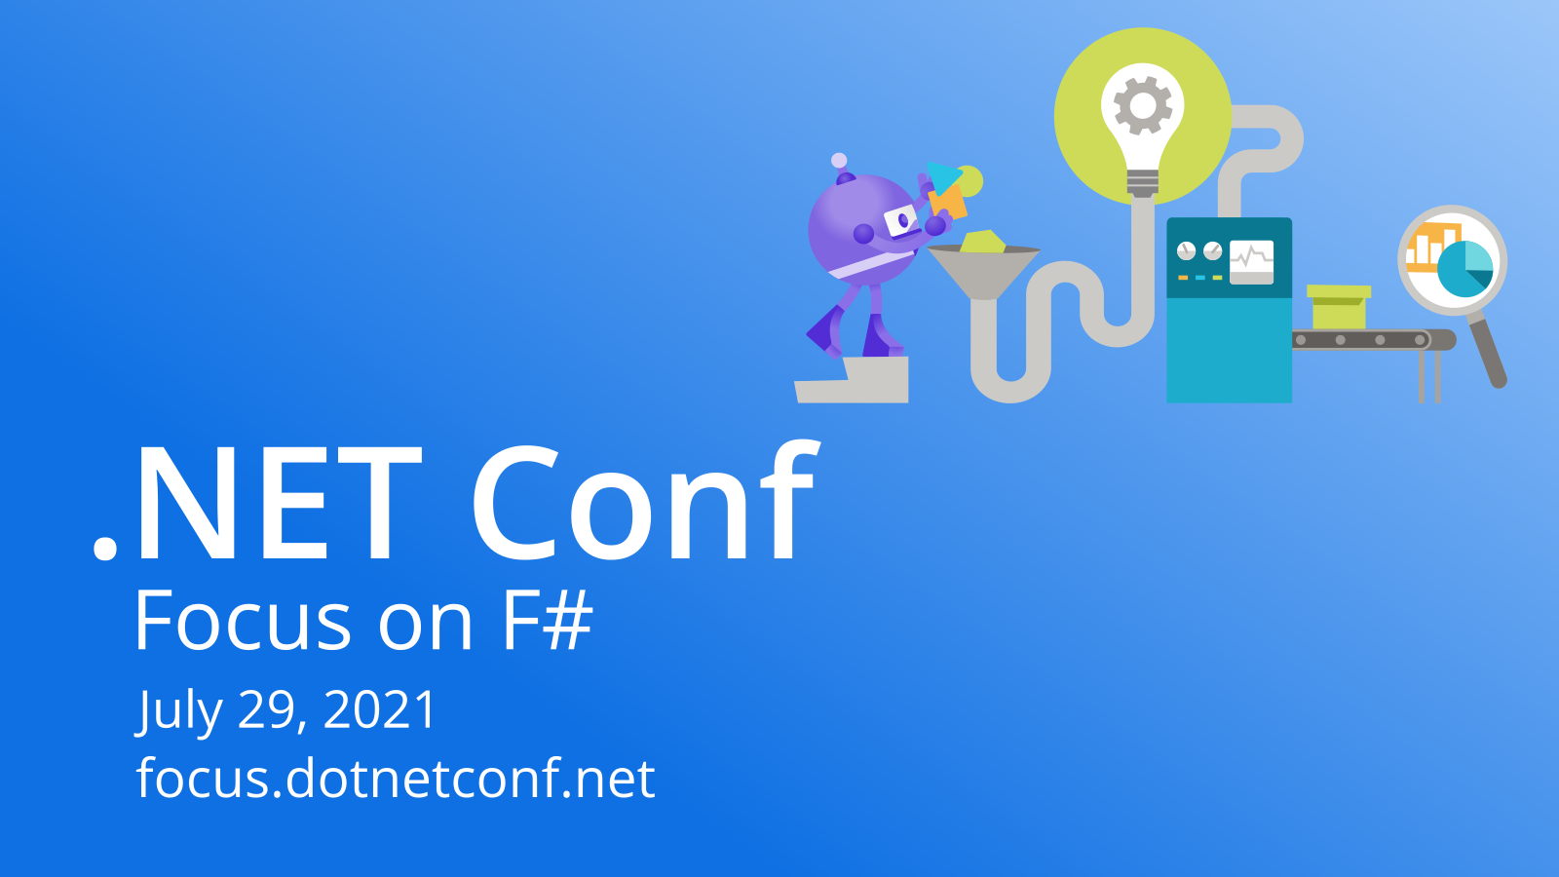

Slide 2

F# Software Foundation & .NET Foundation Q&A
Alan Ball, Board of Trustees – F# Software Foundation
Beth Massi, Board of Directors – .NET Foundation

Slide 3

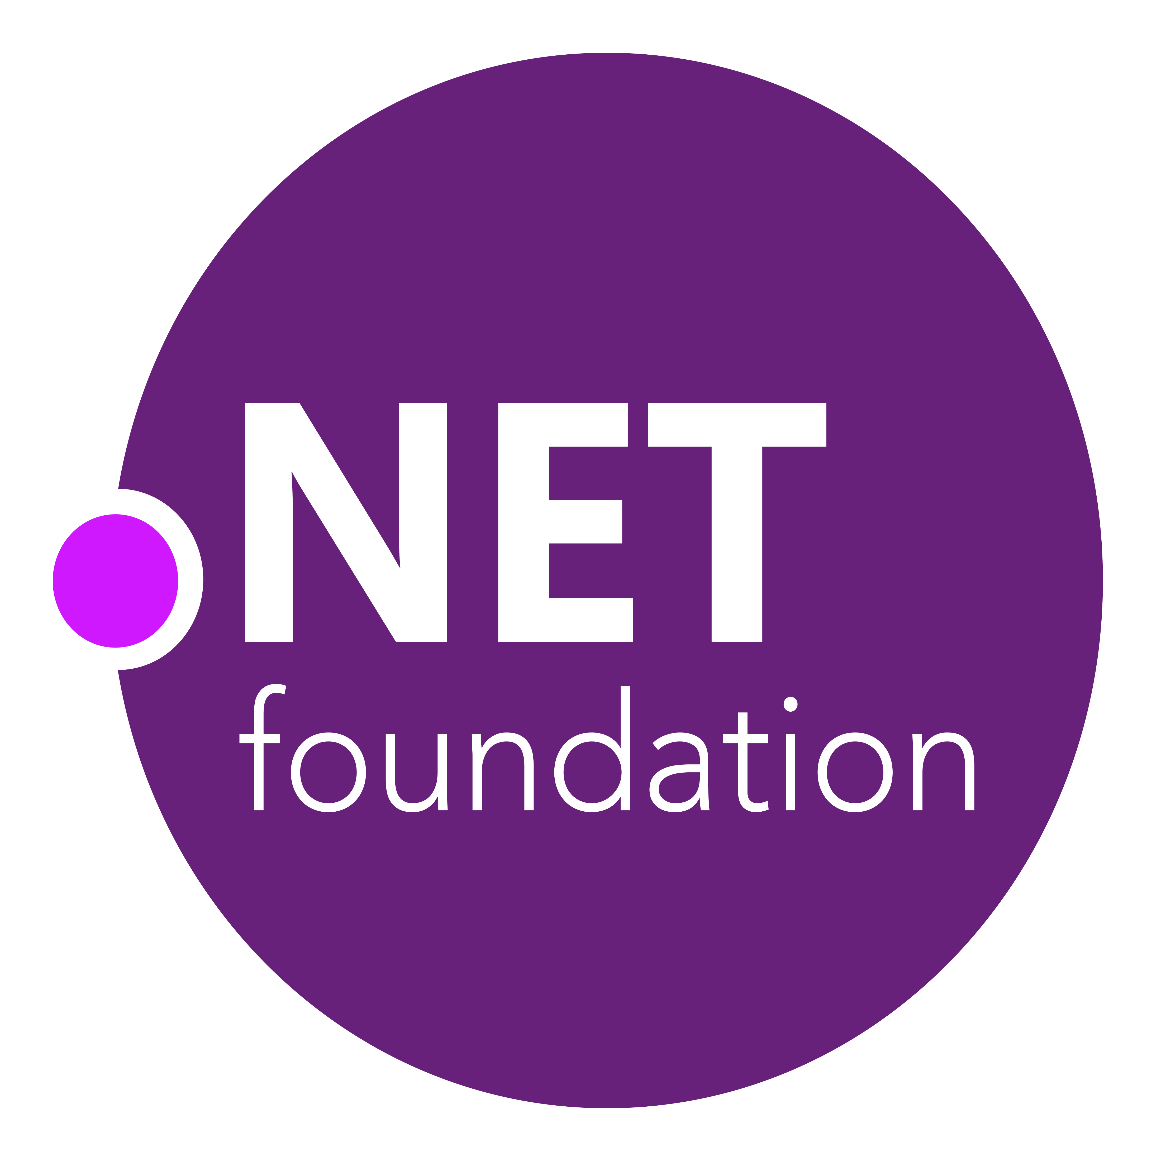


.NET open source journey
2002
NET 1.0 for Windows released. Mono project begins
2008
ASP.NET MVC (web platform) open source
April 2014
.NET Compiler Platform (“Roslyn”) open source
.NET Foundation founded
2016
Mono project joins .NET Foundation
December 2018
.NET Core 2.2 released
WinForms and WPF open sourced
November 2020
.NET 5.0 released. Major releases every November going forward
2001
ECMA 335
2005
F# language released with Apache 2.0 license
2012
F# Software Foundation founded
November 2014
.NET Core (cross-platform) project begins
August 2017
.NET Core 2.0 released
December 2019
.NET Core 3.1 LTS released
Notes:
.NET also went through its own journey to become the huge open source project that it is today.
The biggest moments were in 2014, when the .NET Foundation is established and the C# compiler is open sourced, and later that year the .NET Core project begins in the open. The technology world is shocked, and the .NET community is excited.
Today, .NET 5 has ushered in cross-platform development across chipsets and workloads from hyper-scale cloud all the way down to the smallest of IoT devices.
----Extended talk track----
Dec 2001-Feb 2002
A new platform is born. Along with HP, Intel and others, the ECMA-335 standard was created that defined a common language infrastructure to support multiple programming languages. C# and Visual Basic.NET were released and F# came later in 2007, but there are over 20 other .NET languages today. Visual Studio .NET was released and included C#, VB, C++ development all in one box. This was the first IDE that was truly integrated across multiple languages.
Mono project begins. The CLI spec gave others the ability to create their own .NET implementations. Even though Microsoft built the first .NET Framework for Windows-only, the spec was intentionally portable across OSes and chipsets. The Mono project began, spearheaded by Miguel de Icaza, with the goal to implement Microsoft's new .NET development platform on Linux and Unix-like platforms. Later, Miguel started Xamarin which focused on cross-platform, native, mobile development with C#, built upon Mono. This allows developers to use C# and .NET to build apps for iOS and Android. Unity games development also emerged from Mono.
2008.
ASP.NET MVC web development stack is released to CodePlex as open source. This was the first application development framework from Microsoft to be released as open source. The underlying runtime and compilers were still closed however.
2014
Hell freezes over & pigs fly. Early 2014 at Microsoft’s BUILD conference, Anders Hejlsberg, the father of C#, releases the .NET Compiler Platform “Roslyn” as open source on stage. Later in November, .NET Core project begins in the open. The technology world is shocked, and the .NET community is excited. .NET Core is a new cloud-native implementation of .NET that is geared for cross-platform, hyper-scale services as well as small IoT devices. It’s meant to bring .NET into the next 15 years of computing. And the community has been extremely supportive.
2016
Mono comes home. In early 2016, Microsoft finally acquires Xamarin and brings Miguel de Icaza into Developer Division. Mono joins the .NET foundation and is officially supported and contributed to by Microsoft. The Microsoft community officially meets the Mono community.
2017
.NET Core 2.0 Released. Our cross platform and open source implementation of .NET finally releases to the world with unified tooling support across multiple operating systems and editors.
2018
Winforms and WPF go open source. At Microsoft Connect 2018 we announced the open sourcing of Windows Forms and WPF desktop frameworks. We’ve seen incredible contributions and activity since. The community now has the power to guide the direction of these frameworks.
2019
.NET Core 3.0 released. .NET Core 3.0 brings Windows desktop workloads to the .NET Core runtime which will allow self contained EXEs, side-by-side installs, and faster performance.
2020 and beyond
.NET 5 (the next version of .NET Core + Mono runtimes) released in November 2020. Major releases every November with LTS releases every other year (even numbered versions).

Slide 4


.NET ecosystem momentum
>5M
#1
Top 30
.NET developers
In Visual Studio family
Most loved framework (2019,’20,’21)
.NET Core
Highest velocity OSS projects
github.com/dotnet
Top 5
>10X
>40%
Language on GitHub
C#
Faster than Node.js
ASP.NET Core
New to .NET are students
dot.net download survey
Sources: insights.stackoverflow.com/survey/2019#most-loved-dreaded-and-wanted & insights.stackoverflow.com/survey/2020#most-loved-dreaded-and-wanted & https://insights.stackoverflow.com/survey/2021#section-most-loved-dreaded-and-wanted-other-frameworks-and-libraries
github.com/cncf/velocity/ octoverse.github.com/ https://www.techempower.com/benchmarks/#section=data-r20&hw=ph&test=plaintext
Notes:
We are seeing significant growth in the .NET ecosystem:
There are 5 million monthly active developers in Visual Studio family of tools.
.NET Core has been ranked #1 two years in a row as the most loved framework on StackOverflow developer survey.
Cloud Native Computing Foundation (CNCF) tracks the highest velocity projects on all of GitHub which they measure by the rate at which pull requests and issues come in & how many are accepted, and dotnet projects are consistently in in the top 30 since 2017. dotnet ranks # 1 in most active in 2021.
Speaking of GitHub, C# is in the top 5 languages, an indicator of a healthy open source ecosystem.
And the .NET contributors are extremely proud of their work on performance. ASP.NET Core ranks #1 web framework in the TechEmpower benchmarks, an independent, open source set of web performance benchmarks that measure dozens of languages and application frameworks, .NET has the fastest web framework on the planet. faster than C++, Java and Go.
Lastly, we continue to see a large part of new users downloading .NET identifying as Students in the download survey, which gets thousands of responses a week indicating a healthy growth trajectory.
All this is possible because of open source collaboration.
Sources:
https://insights.stackoverflow.com/survey/2021#section-most-loved-dreaded-and-wanted-other-frameworks-and-libraries
https://github.com/cncf/velocity/
https://octoverse.github.com/
https://www.techempower.com/benchmarks/#section=data-r20&hw=ph&test=plaintext

Slide 5


.NET is in the top-30 highest velocity open source projects
7/1/2018 - 6/3/2019
Linux
Chromium
Kubernetes
Elasticsearch
Homebrew
dotnet
VS Code
React
https://github.com/cncf/velocity/
https://github.com/cncf/velocity/blob/master/reports/top_projects_by_activity.txt
Notes:
One of our biggest open source projects is the .NET itself.
Open Source projects exhibit natural increasing returns to scale. That’s because most developers are interested in using and participating in the largest projects, and the projects with the most developers are more likely to quickly fix bugs, add features and work reliably across the largest number of platforms. So, tracking the projects with the highest open source velocity can help illuminate promising areas in which to get involved, and what are likely to be the successful platforms over the next several years.
CNCF tracks the top 30 highest velocity open source projects. This is a logarithmic scale to measure OSS project velocity with commits on the X axis and PRs and issues on the Y axis, with # of authors indicated by the size of the circle. The farther upper right the more activity a project has. Notice .NET is the #1 application framework in this ranking.
Jim Zemlin, Executive director of Linux foundation said “There are 10’s of millions of open source projects, invest in the ones with sustainable ecosystems”. .NET is one of those projects.
Sources:
https://www.cncf.io/blog/2017/06/05/30-highest-velocity-open-source-projects/
https://www.cncf.io/blog/2021/08/02/update-on-cncf-and-open-source-project-velocity-2020/
https://docs.google.com/spreadsheets/d/1kAVjxNcpcwj6Al81SXzy2cgzrumz0-num-m_aT4F3hE/edit#gid=134798507

Slide 6
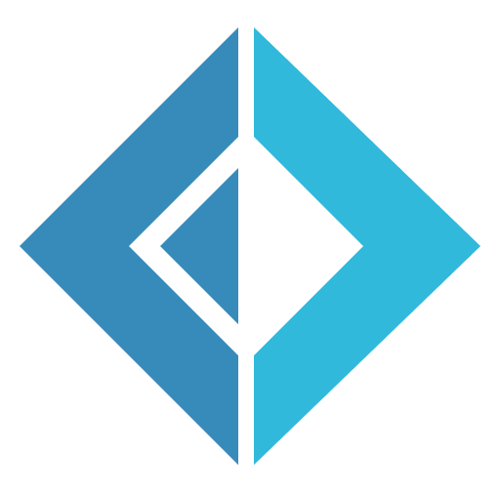
fsharp.org

Slide 7
F# Software Foundation
Mission
Grow, support, and educate a diverse community around the F# programming language ecosystem

Slide 8
Leadership team
Kevin Avignon
Alan Ball
Pim Brouwers
Elliot Brown
Philip Carter
Dave Curylo
Janne Sierra
Reed Copsey, Jr.
foundation.fsharp.org/board_and_officers

Slide 9
F# initiatives
F# Foundation Slack & Forums
Community Diversity Program
User Groups
Speaker Program
Events
Mentorship Program
The best place to start as a beginner or experienced developer
Connecting developers to a experienced F# project maintainer who can help them improve their F# programming skills, and best practices for developing in F#
Supports members of underrepresented minorities for attending conferences, training courses, and other community events
F# User Groups Collaboration with .NET User Groups
Helping support speakers for events and meetup groups
Applied F# Challenge, F# Game Jam

Slide 10
How to get involved
Join the Slack
Join one of our programs
Become a mentor/mentee
Sign up at fsharp.org

Slide 11

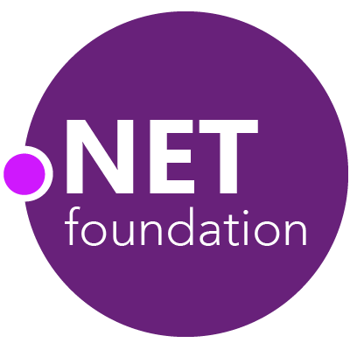
Reaqtive
Steeltoe
.NET
MSBuild
DotNetNuke
Coverlet
ASP.NET Core
SourceLink
NuGet Trends
Pwned Passwords
nUnit
MVVM Light Toolkit
IronPython
Mailkit
WorldWide Telescope
Nancy
Open XML SDK
.NET SDK for Hadoop
MEF
dotnetfoundation.org/projects
MvvmCross
Mimekit
xUnit
Esquio
NuGet
Polly
ImageSharp
iOS
macOS
WCF
Entity Framework
.NET ECOSYSTEM
ILMerge
Xamarin.Mobile
ASP.NET SignalR
ReactiveUI
Open Live Writer
Mono
Xamarin.Auth
Xamarin SDK
Orchard CMS
Nerdbank.GitVersioning
ProtoBuild
.NET nanoFramework
Verify
.NET Compiler Platform ("Roslyn")
Prism
Kerberos.NET
Cake
Orleans
Kudu
Cecil
LLILC
Umbraco
System.Drawing
MahApps.Metro
Notes:
The .NET Foundation is our center of gravity for open development and collaboration around the .NET ecosystem. Its mission is to support an innovative, commercially friendly, open-source ecosystem around the .NET development platform.
The .NET Foundation has over 100 projects and hundreds of repos under its stewardship. Open Source Software foundations provide protection, support, services and best practices for helping projects be successful and to grow the ecosystem of people and software.

Slide 12
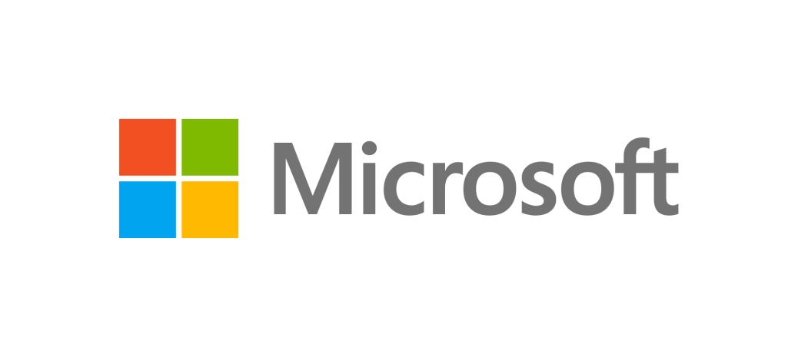
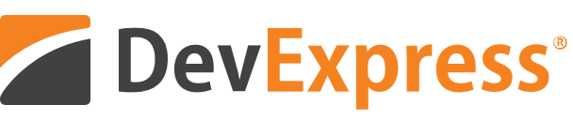


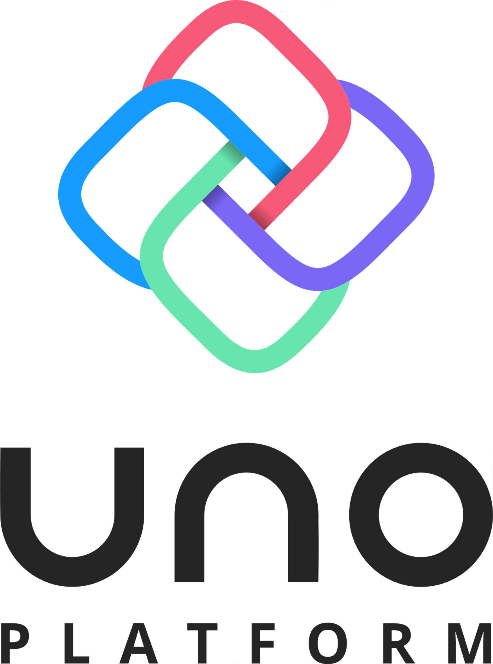
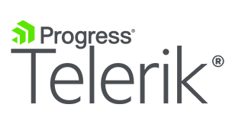


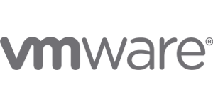

CORPORATE SPONSORS
These companies are helping grow the .NET ecosystem
Notes:
So who’s behind the .NET Foundation? It’s not just individuals, it’s large companies that are invested in the future of .NET. .NET is bigger than Microsoft. The corporate sponsors of the .NET Foundation are helping guide the .NET ecosystem into the future together with industry partners.

Slide 13
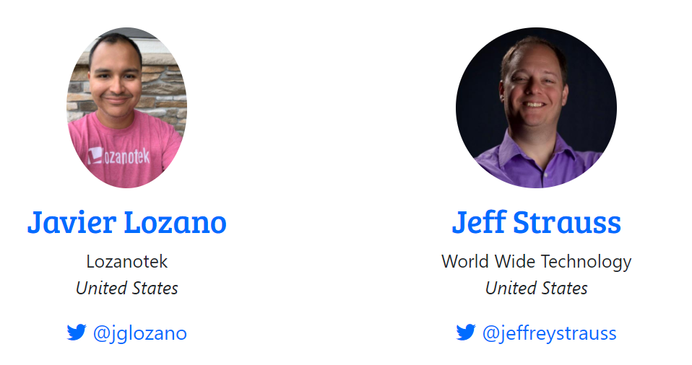
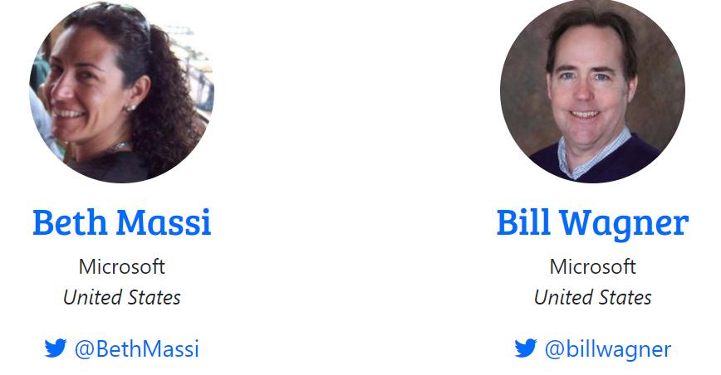
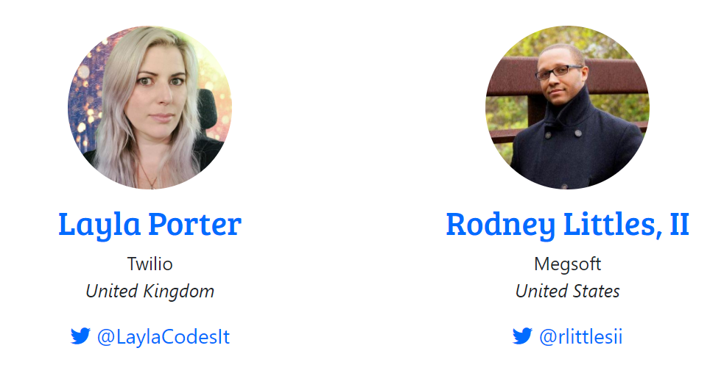

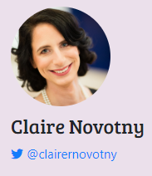
Leadership team
Executive Director
Notes:
The board comes from the passionate .NET community. Here is the elected board of the .NET Foundation, elected in July 2020, except for Beth Massi who is appointed by Microsoft.
<CLICK>
Claire Novotny, is our Executive Director, who also now also works for Microsoft.

Slide 14
Committees
Projects
Membership
Marketing
Sponsorship
Education
Outreach
Executive
Onboarding, governance, licensing, mentorships, project services
Community activities, meetups, diversity
Member support, benefits, elections
PR, project GTM, events, web presence, social, comms, SWAG
Funding, Technical Steering Group
.NET Foundation Academy, curriculum, scholarships
Processes, “Running the business”
dotnetfoundation.org/community/committees
Notes:
The board also heads a variety of committees with our members.
Projects – new projects onboarding, governance, mentorships – Chair = Shaun Walker
Outreach – support community activities & diversity
Sponsorship – brings in funding, organizes technical steering group
Membership – member support, benefits, board elections
Marketing – PR, Project GTM, events, web presence, social, communications, SWAG
Education – new one, driven by a passionate member – Brian Jablonsky
Executive – defines processes, RoB

Slide 15
Project services
IP / Legal Support
Review as projects join
Certificates
Code Signing (via d/b/a)
Legal services
CLA
d/b/a registration
HTTPS
DevOps
CI/CD
Package Feeds
Hosting
Web hosting
Service hosting
DNS
SAAS
Office 365
Slack
LastPass
Notes:
So what does the .NET Foundation do? Here are just some of the services we proved to projects. Learn more: https://dotnetfoundation.org/about
We t to take care of ALL the stuff that’s not writing code. All that infrastructure a project needs to be successful. From tracking contributor license agreements, to code signing, CI/CD, we try to be there to make our projects successful by doing the “boring” infrastructure stuff.

Slide 16
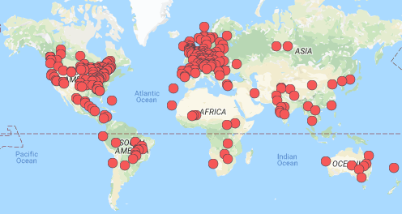
.NET Foundation sponsored meetups
Members
330K+
Groups
380+
Countries
70+
meetup.com/pro/dotnet
Notes:
We’re a huge community and the .NET Foundation is key to help foster it. We have over 5 .NET million developers worldwide and .NET has grown its developer base by 1 million over the last year. There are meetups all over the world that speak on all sorts of .NET topics and application development and we’ve also seen a lot of growth in membership. Here are the ones on meetup.com.
Last year when the pandemic hit, the outreach committee created a Virtual User Group meetup group to support virtual meetings and streaming services to the .NET Foundation YouTube channel.

Slide 17

Elections are here
Any member can run for the board
Elections take place in August 4-18
dotnetfoundation.org/about/election

Slide 18
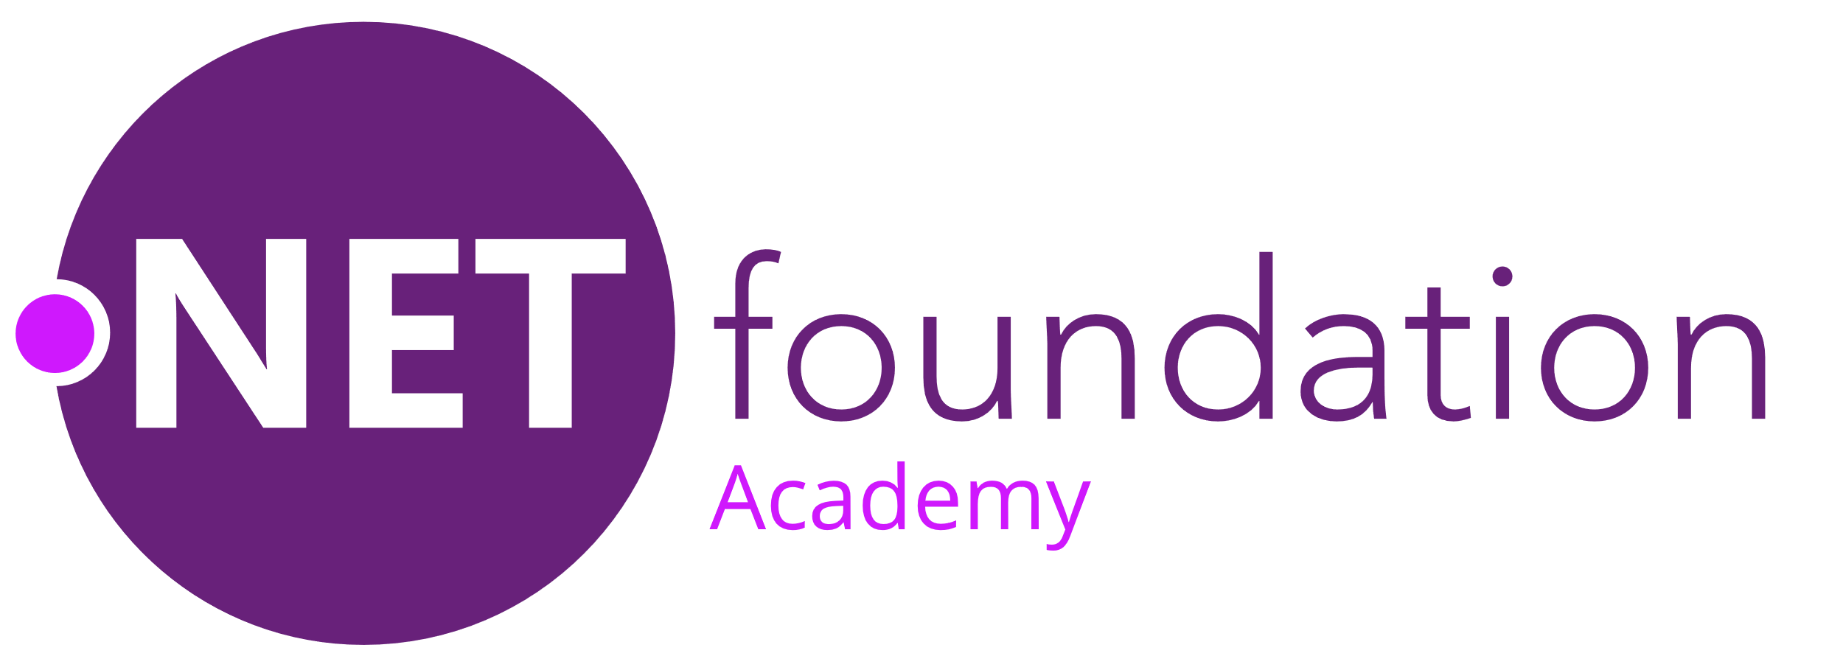
.NET Foundation Academy
Education committee is developing a program for higher education computer science students to learn about software development with .NET
Looking at partnership opportunities with F# Software Foundation
Get involved:
github.com/dotnet-foundation/wg-education

Slide 19






How to get involved
Apply for membership dotnetfoundation.org/member
Find a meetup meetup.com/pro/dotnet
Get the news aka.ms/dnfnewsletter
Contribute to a project dotnetfoundation.org/projects
Nominate your project dotnetfoundation.org/projects/submit
Nominate your meetup aka.ms/add-dotnet-meetup

Slide 20

Ask your questions live on Twitter #dotNETConf
Q&A

Slide 21
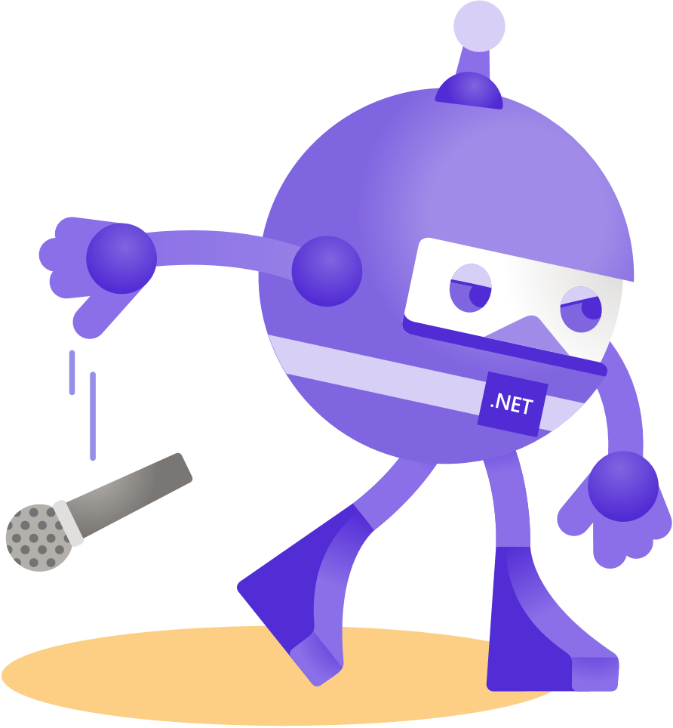
Thanks for joining!
Ask your questions live on Twitter #dotNETConf

